Slide 1
SDMX and DDI: How Do They Fit Together in Practical Terms?
Arofan Gregory
The Open Data Foundation
European DDI User’s Group 2011
Gothenburg, Sweden

Slide 2
Outline
Background
Characterizing the Standards
DDI
SDMX
Similarities and Differences
Other Relevant Standards
Implementation Approaches
DDI In, SDMX Out
SDMX-Centric
Standards Agnostic
Future Possibilities: The SDMX-DDI Dialogue Proposal

Slide 3
Background
This presentation intends to examine the different architectural approaches to implementations of SDMX and DDI together
While several organizations are mentioned, it is not a report on the status of prototypes or implementations
This presentation does not intend to introduce DDI or SDMX to an unfamiliar audience
Familiarity with the standards is assumed

Slide 4
Background (2)
When people think about using SDMX and DDI together, they make assumptions
Microdata (and tabulations) can be described using DDI
A transformation could be applied to produce SDMX to describe the aggregates/tables
There is a straight mapping from DDI to SDMX
Interestingly, this conceptual model is not how the use of DDI and SDMX together is being approached in reality
The Devil is in the details! (Or is it “The Tomten is in the details” ?)

Slide 5
Background (3)
People have been discussing the use of SDMX and DDI together for some time
Now, we are at the stage where implementations are being investigated and prototyped
Not “if”, but “how”
Most often, this is done in the context of the Generic Statistical Business Process Model (GSBPM), by data producers
The idea of “industrialized” statistical production
Strong emphasis on process management

Slide 6
Characterizing the Standards: DDI
DDI Lifecycle can provide a very detailed set of metadata, covering:
The study or series of studies
Many aspects of data collection, including surveys and processing of microdata
The structure of data files, including hierarchical files and those with complex relationships
The lifecycle events and archiving of data files and their metadata
The tabulation and processing of data into tables (Ncubes)
Allows for a link between the microdata variables and the resulting aggregates

Slide 7
Characterizing the Standards: SDMX
Describes the structure of aggregate/dimensional data (“structural metadata”)
Provides formats for the dimensional data
Provides a model of data reporting/collection and dissemination
Provides a way of describing the structures of arbitrary metadata sets (“reference metadata”)
Provides formats for the arbitrary metadata sets
Provides a set of standard registry interfaces, providing a catalog of resources
Provides guidelines for deploying standard web services for SDMX resources
Provides a way of describing statistical processes

Slide 8
Differences
DDI has much more detailed metadata at the level of the study, because it is intended to describe the full process of data production (the data lifecycle)
DDI provides more complete descriptions of the processing of data
SDMX provides more architectural components, to support reporting/collecting and exchange

Slide 9
Similarities: Design
Both standards use a similar mechanism for structuring URN identifiers
Both standards use a similar model for identifiable, versionable, and maintainable things
Both have a concept of an owning agency
There is a very similar set of rules about versioning and maintenance
Both standards use “schemes” as packages for lists of like items
Both standards are designed to support reuse, and have similar referencing models

Slide 10
Similarities: Specific Metadata Items
Concept Schemes
SDMX Codelists/DDI Codes and Categories
Dimensional data structures (Ncubes/DSDs)
Organization Schemes
There is an effort as part of the SDMX-DDI Dialogue to produce a common vocabulary of terms, describing similarities and differences

Slide 11
Other Relevant Standards
Some things are not covered well by either SDMX or DDI, particularly classification management
The Neuchatel model is probably a better standard, but it has no standard XML representation
The older (and similar) CLASET model is also potentially useful, and does have an XML representation
The GSBPM gives us a generic model for describing business processes, but to implement process management you will use other standards such as BPMN (specific process modelling) and BPEL (for executing processes)

Slide 12
Implementation Approach: DDI In, SDMX Out
This is an approach used by the Australian Bureau of Statistics (ABS) in one part of their microdata access facility, REEM
It is based on a set of software tools developed and sold by Space-Time Research (“SuperCross”) to support tabulations from microdata

Slide 13
DDI In, SDMX Out
Run
Time
Process
Production
Time
Process
REEM Tabulation Tool
<DDI 3.1>
STR Database Format
ASCII
Microdata
File
<SDMX
2.0>
Run
Time
Process

Slide 14
Considerations
This is a limited implementation, providing secure access to microdata in the form of user-defined tabulations
It is only a limited dissemination scenario
It relies on run-time confidentialization, which limits the data that can be made available (only data and tabulations for which robust automated confidentialisation can be assured)
The internal formats are proprietary, and lack some of the richness of the DDI-L model
We also identified some bugs in DDI 3.1
Not sufficient for users who wish to perform statistical analysis of the microdata rather than produce tabulations
That need will be met by another part of the overall REEM solution in future
There is no direct mapping from DDI to SDMX

Slide 15
Implementation Approach: SDMX-Centric
This approach came out of discussions within INSEE, as they considered designs for the new metadata repository they are developing
Similar approaches have been considered by other organizations
This relies heavily on the use of the SDMX architectural components and model, especially the SDMX Registry
There is an idea of GSBPM-based process management, but no process-management tool

Slide 16
Process
Metadata
Management
Resource
Coordinator
Dissemination
Database(s)
SDMX
Metadata
Reports
Dissemination
SDMX
Registry
Quality
Metadata
Management
SDMX
Registry
SDMX
Metadata
Reports
5 different things:
DDI Categories & Codes;
SDMX Codelists,
Hierarchical Codelists,
Categories
SDMX MD Reports, DDI Instances
SDMX
And DDI
Concepts
Classification
Management
Study Unit
Management
(Instruments,
Groups)
Concept
Management

Slide 17
MSD for DDI
This represents a DDI instance
Is Registered
<DDI>
SDMX
Metadata
Report
SDMX
Registry
Application
Query is made
on the
MD Report (not the DDI)
Application reads
the MD Report
and can then
go and get the DDI,
Response contains pointers
to the DDI resource

Slide 18
Considerations
The SDMX Registry is available as a free tool, reducing the amount of development needed to deploy such a system
Other SDMX tools are also available for free
Applications are coded against specific versions of the standards, coming with fairly high maintenance costs if future versions need to be supported
Access to non-SDMX resources (DDI) involves a level of indirection
Retrieval is a two-step process: first get the “placeholder” SDMX Metadata Report, process it, and then retrieve the non-SDMX resource (DDI)
The GSBPM was described as a set of SDMX Processes, and these are held in the registry to help organize and manage the statistical production process

Slide 19
Implementation Approach: Standards Agnostic
This approach is currently being prototyped by the ABS, as part of a major re-development of their IT infrastructure to “industrialize” their production processes
It is a registry-based, distributed model, but it does not rely on the SDMX Registry, but on a standards-agnostic registry
It is also based on the GSBPM, and on the emergent sibling to it, the Generic Statistical Information Model (GSIM)
There is a major component of process management and automation

Slide 20
Business Process
Management
Rules
Engine
ID Service
Other
Services
Resolution
Service
BP Instance
Repository
Rules
Repository
Metadata
Registry
Services
Registry
Metadata
Repositories
Schema
Repository
Centralized
Metadata
Repository
Centralized
Data
Repository
Access/
User
Management
Corporate
Directory
Data
Repositories

Slide 21
Registration of a New
Metadata Object
Access control
service
Metadata
Repository
(2) Write access
Is determined for MD object
Metadata
Registry
MD object
published to
repository
(8) Properties
and relationships
stored in registry;
BP instance
status
updated
(4) MD object
(and location)
obtained
(3) BPMS invokes
the registration
service
Registration
service
(7) Indexing
service is
invoked
(9)Registration
response sent with
errors/warnings
and/or success
BPMS
Object-type-specific
indexing service
(6) Location
and ID are
stored
(5) Valid ID
for MD object
obtained
ID service
Resolution service

Slide 22
Standards Agnosticism
The term “standards-agnostic” means that the standards themselves are represented as metadata objects within the registry
Each version of each relevant standard is described as either a read-only or a sufficient read-write format for any type of object
Every metadata object describes which versions of which standards are supported
Transformation services between standards and versions are also registered resources
Introducing new standards or new versions of new standards has a minimal impact on existing applications
Some “standards” could be agreed organization-wide standards, not necessarily public standards such as DDI and SDMX

Slide 23
Considerations
There is a huge emphasis on process automation and management
All functionality is exposed as web services – this is an “SOA” architecture which works well with existing process management tools
The cost of developing and deploying the new infrastructure will be very high
Migration from legacy systems will be challenging
Organizational change issues will need to be overcome
The value of deploying such a system will be immense
Flexibility and speed will be greatly increased for statistical production
Management of the statistical production process will be easier and more effective
Consistency and quality of the data products will be enhanced

Slide 24
Future Possibilities: The SDMX-DDI Dialogue Proposal
There has been a set of informal meetings between members (and prospective members) of the SDMX community and the DDI community, looking for ways in which the standards can be used together effectively
The first meeting was held at EDDI 2010
There have been several other meetings since
One proposal is now being discussed which outlines an approach to using SDMX and DDI interchangeably

Slide 25
A Simple Fact
Its not about which flavor of XML you use – XML doesn’t really matter
It’s about the data and the metadata!

Slide 26
The Challenge
If I want to use DDI to describe my data, and you want to use SDMX, how can we ensure that we are getting the same data and metadata?

Slide 27
The Proposed Approach
The SDMX-DDI Dialogue has been defining a set of relevant business cases where the two standards could be used together
One of these business cases involves retrieving unit record data from a register
A model of the full set of useful data and metadata has been identified
The metadata is a subset of the DDI elements, which could be expressed in DDI as a “DDI Profile”

Slide 28
The Proposed Approach (2)
The full set of information includes:
The unit record data
Structural information about the variables and representations
Additional information about how the data has been generated/collected/processed
In DDI, this set of information can be expressed as a DDI instance and a data file
Both the structural and processing metadata can be expressed as a single DDI instance

Slide 29
The Proposed Approach
In SDMX, we have three XML files:
A file holding the data, expressed as dimensional microdata
The unit identifier is a dimension
The variable identifier is a dimension
There are dimensions related to time
A reference metadata report will all other metadata describing the process/collection/generation of the administrative data
A file describing the concepts, data structure, and codelists (“structural metadata”) for the data, and also the structure of the metadata report

Slide 30
Metadata
Set
Unit Record Data
DDI Instance
ASCII Data File
SDMX Data
Set
SDMX Structural
Metadata
SDMX Metadata
Report

Slide 31
Results
If I am using SDMX, but I am sent DDI, a simple transformation will give me the same payload of data and metadata
Vice-versa for SDMX users
There are some conventions which will need to be established regarding identifiers and the way the unit record files are structured
There will need to be agreed models for each business case

Slide 32
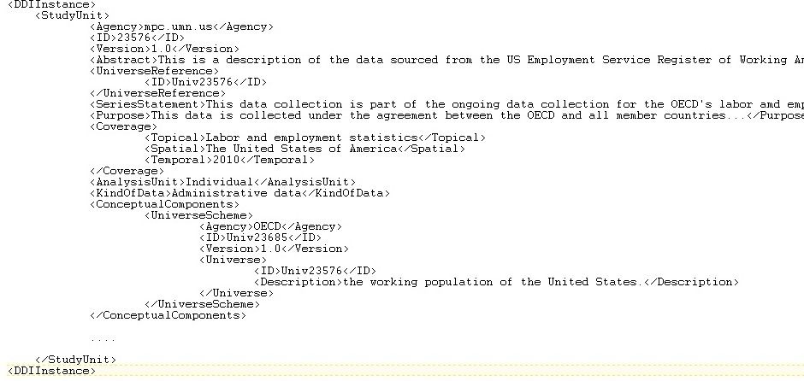
An SDMX File?

Slide 33
Questions?

